Slide 1
Internship Project Report on Exploratory Data Analysis on Real Estate Pricing
NEXTHIKES IT SOLUTIONS
Name:-Kareena Aneja
Role:- Data analyst Intern
Date:-31st Jan,2026

Slide 2
About the Project
House pricing depends on many factors like size, quality, rooms, and amenities. As an intern, my goal was to explore the data and understand which factors affect prices the most.

Slide 3
Objective of the Project
To understand how house prices are distributed
To find which features affect house prices the most
To analyze relationships using data visualizations

Slide 4
Dataset Description
Dataset used: Ames Housing Dataset
It contains information about house size, quality, rooms, year built, and price
Target variable: SalePrice

Slide 5
Tools and Libraries Used
Python for data analysis
Pandas for data handling
Matplotlib and Seaborn for visualization

Slide 6
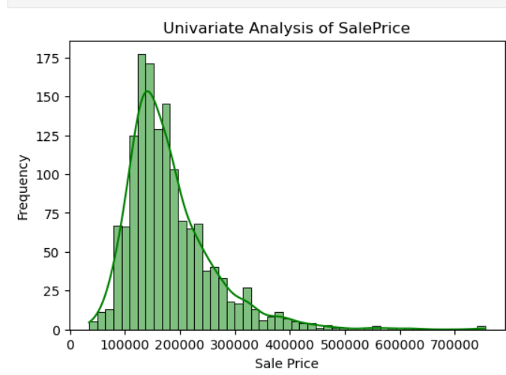
Univariate Analysis
Univariate analysis was done to study one variable at a time. I analyzed SalePrice to understand how house prices are distributed.
Most houses fall in the mid-price range
Few houses have very high prices

Slide 7
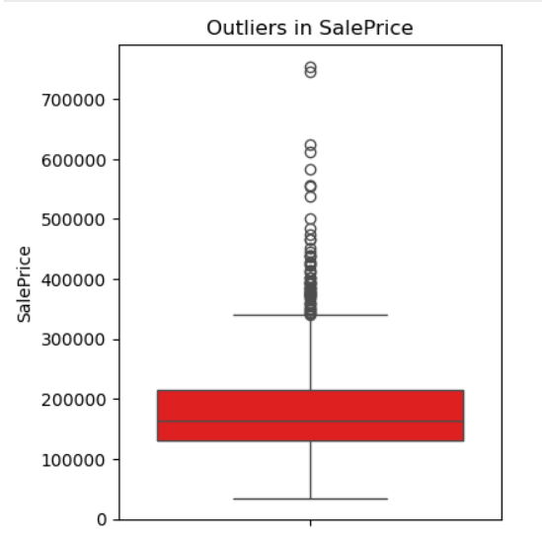
Outlier Analysis
Some houses have very high prices compared to others. These values are called outliers.
Outliers were identified using boxplots
They were handled carefully to avoid losing important data

Slide 8
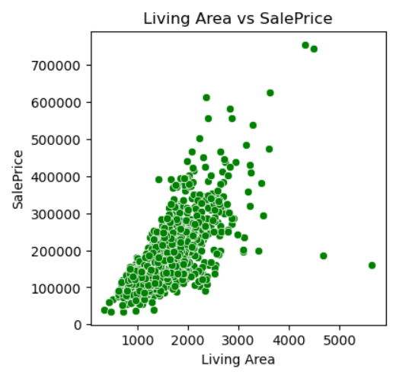
Bivariate Analysis
Bivariate analysis was used to study the relationship between house price and one feature at a time.
Key observations:-
Larger houses usually have higher prices
Better quality houses are more expensive

Slide 9
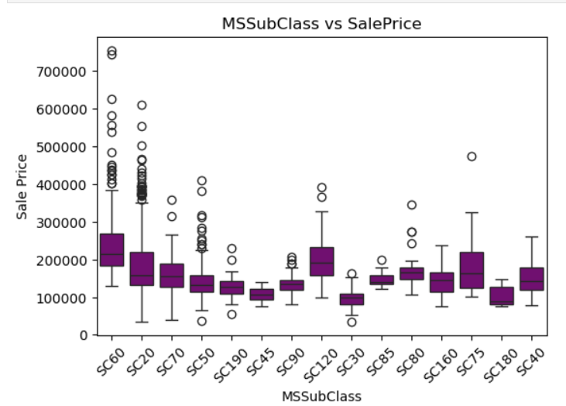
MSSubClass Analysis
Different house types have different price ranges.
Some house types are more costly
Some are more affordable
House type also impacts pricing

Slide 10
Multivariate Analysis
Multivariate analysis was done to study the combined effect of multiple features on house prices.
Multiple factors work together to affect price
Size, quality, and amenities all matter together

Slide 11
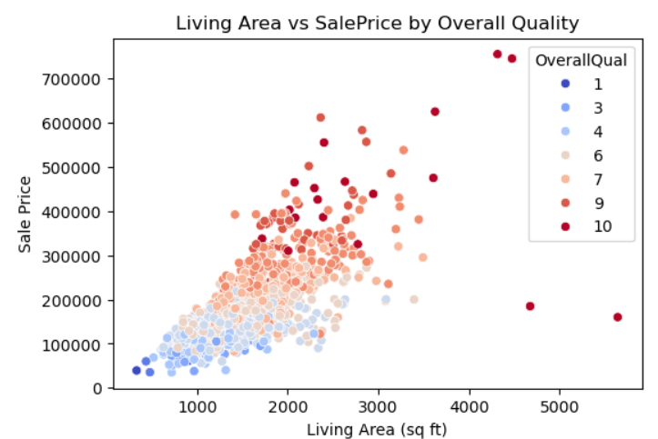
Combined Effect – Size & Quality
This graph shows size and quality together.
For same size houses, better quality means higher price
Both features together affect pricing

Slide 12
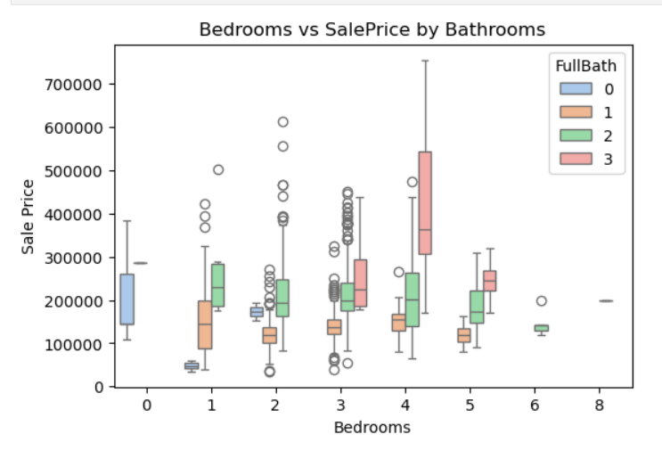
Combined Effect – Rooms & Bathrooms
This graph shows bedrooms and bathrooms together.
Houses with more bathrooms are costlier
Comfort features increase price

Slide 13
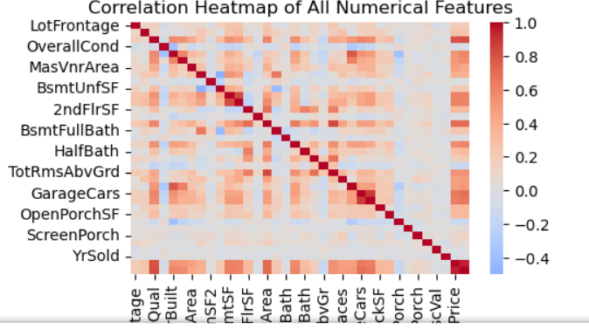
Correlation Heatmap (All Numerical Data)
This heatmap gives a complete and unbiased view.
Shows all numerical features together
Confirms which features affect price the most

Slide 14
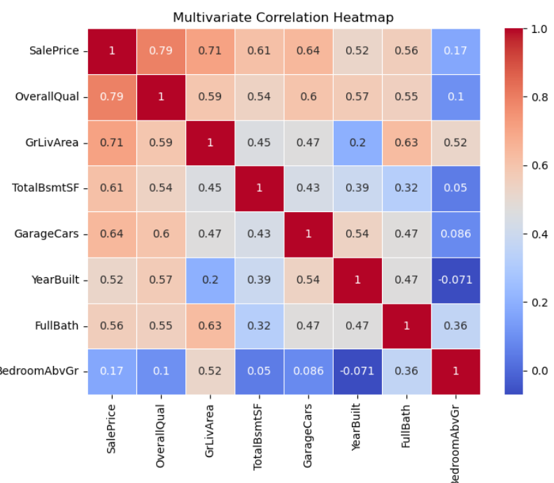
Correlation Heatmap (Selected Features)
This heatmap shows how strongly features are related to price.
Overall quality and size have strongest correlation
Garage and basement also matter

Slide 15
Conclusion
From this analysis, we conclude that:
House prices mainly depend on quality and size
Amenities and newer construction also increase price
Exploratory Data Analysis helps in making better pricing decisions

Slide 16
THANKYOU

